Slide 1

Functional Programming
in Swift
Chase Banyai
Andrew Januszko
A. Zarr, “When You Write Code in Swift, Write Code in Swift,” Geek Culture, Mar. 31, 2021. https://medium.com/geekculture/when-you-write-code-in-swift-write-code-in-swift-abdac43d44fa (accessed Mar. 28, 2022).

Slide 2
Overview
Background
What is Swift?
“Hello, World” in Swift
What is a Guard?
Haskell Functions
Haskell implementation
Haskell-esque Swift implementation
Native Swift implementation

Slide 3
Background

Slide 4
What is Swift?
Developed by Apple, released in 2014
Successor to Objective-C
Static, strong, inferred language
Static - Errors can be found at compile time
Strong - Exceptions and errors can be found at compile time for variable typing
Inferred - variable types can be determined by the data it holds
General purpose language
Application development

Slide 5
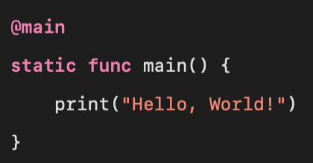
“Hello, World” in Swift

Slide 6
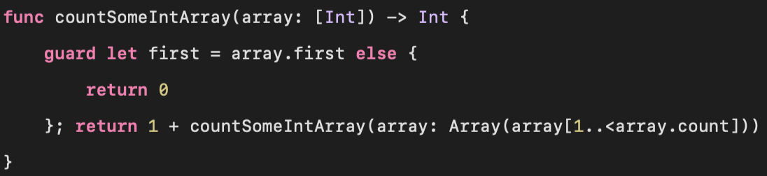
What is a Guard?
A guard is like an if statement, but if the condition is not met then it will enter the else block. This keeps the program below from throwing an error if there is no first in the array.

Slide 7
Haskell Functions

Slide 8
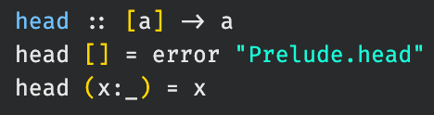
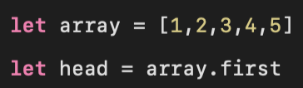
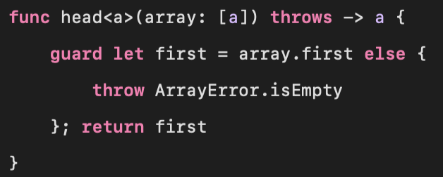
head :: [a] -> a
Haskell
Swift
Native Swift

Slide 9
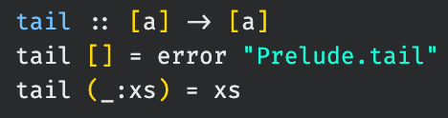
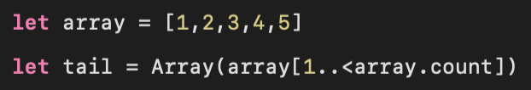
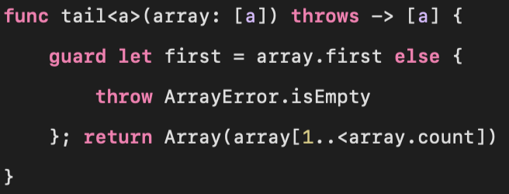
tail :: [a] -> [a]
Haskell
Swift
Native Swift

Slide 10
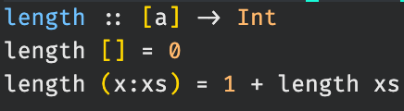
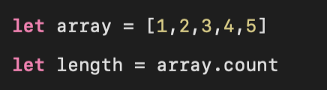
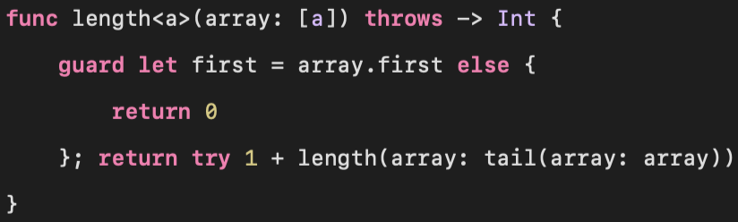
length :: [a] -> Int
Haskell
Swift
Native Swift

Slide 11
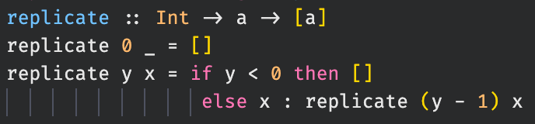
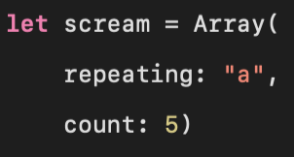
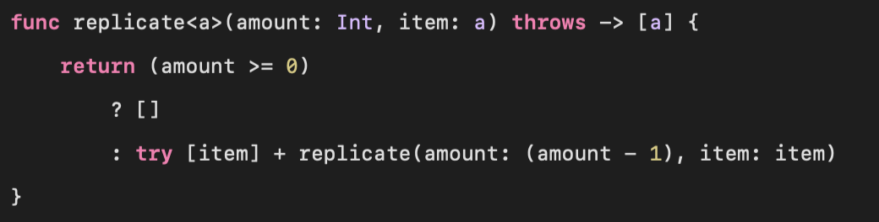
replicate :: Int -> a -> [a]
Haskell
Swift
Native Swift

Slide 12
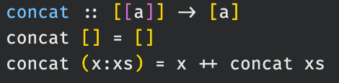
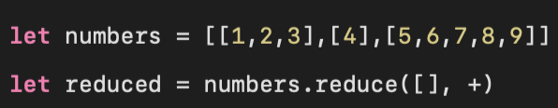
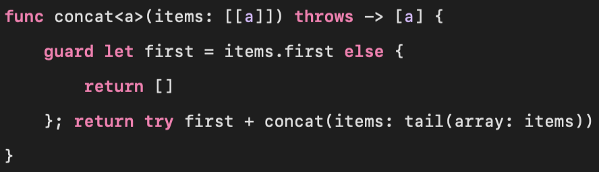
concat :: [[a]] -> [a]
Haskell
Swift
Native Swift

Slide 13
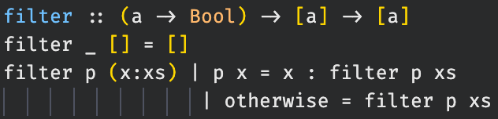
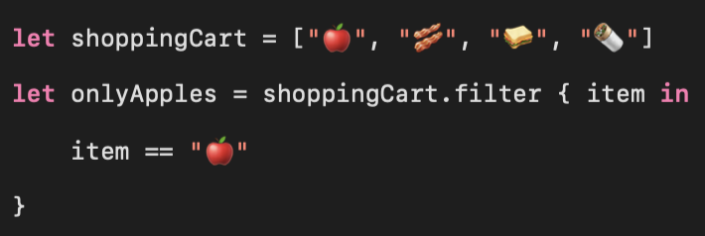
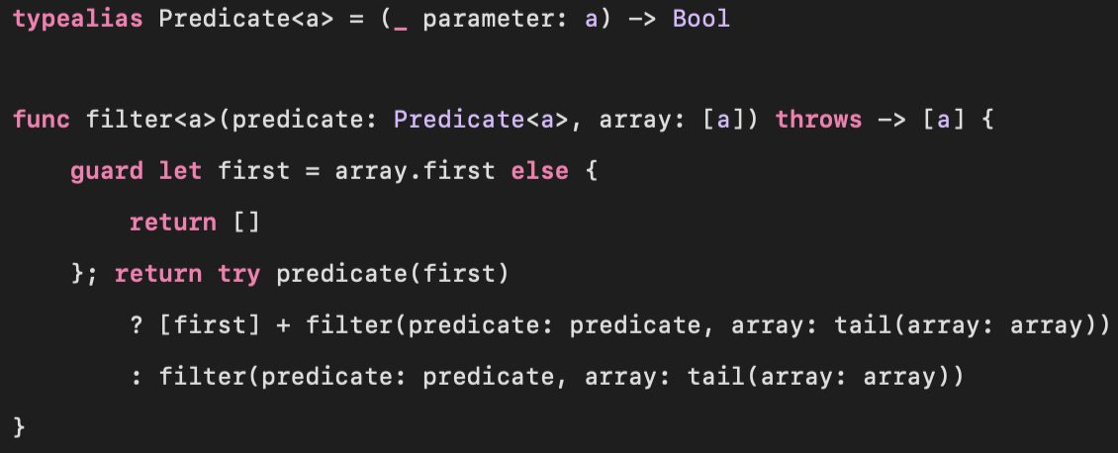
filter :: (a -> Bool) -> [a] -> [a]
Haskell
Swift
Native Swift

Slide 14
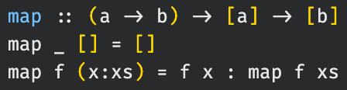
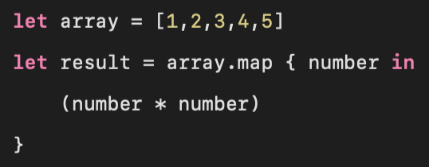
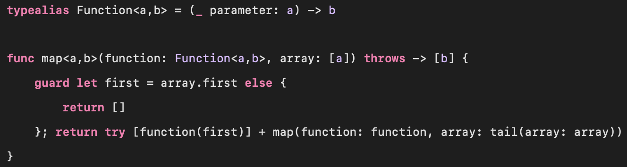
map :: (a -> b) -> [a] -> [b]
Haskell
Swift
Native Swift

Slide 15
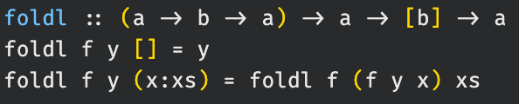
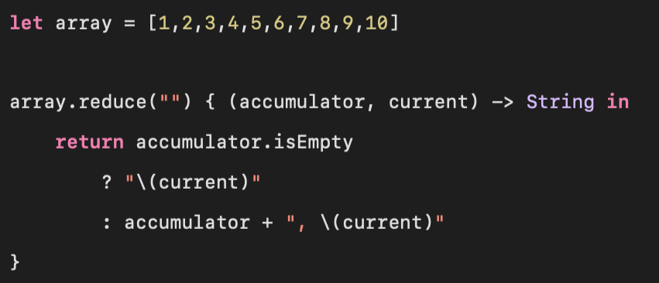
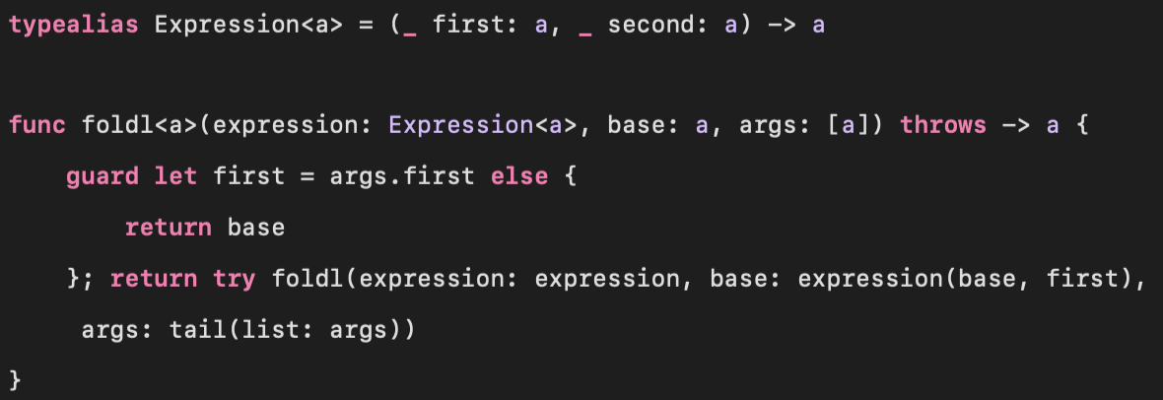
foldl :: (a -> b -> a) -> a -> [b] -> a
Haskell
Swift
Native Swift

Slide 16
Conclusion
Swift is a flexible language that could be used for functional programming.
Not every haskell function maps to a swift function.
Swift is still a relatively new programming language.
Less than a decade old
More functional programming aspects could be added as it develops.

Slide 17
Any Questions?

